Slide 1
React-Redux flow
React – it’s a view..
Redux – it’s a store

Slide 2
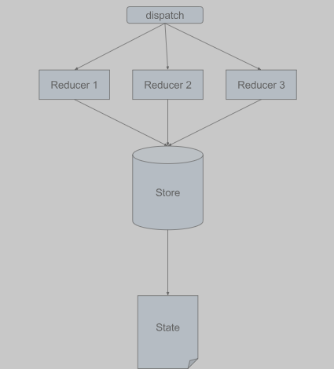
Redux state management flow:

Slide 3
Steps to redux state management flow
Store can be modify by anyone
Store modification done through reducers
We can trigger reducer by dispatching action as shown to above slide.
We have to dispatchnan action if we need to change the data.
If we need data , we have to get the current state of the store

Slide 4
Linking react app with redux
Our child components need to know where is store and this store info is served by Provider which is taken care by reacct –redux library.
I mean “provider” provides info about store to the child components
Keep complete react app component within Provider so entire app will access store.
//This is the store we create with redux's createStore method
const store = createStore( todoApp, {})
// Provider is given the store as a prop
render(
<Provider store={store}>
<App />
</Provider>,
document.getElementById('app-node')
)

Slide 5
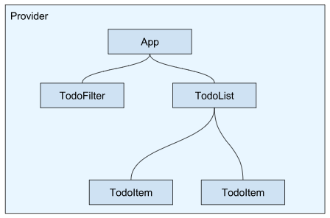
Entire app kept within Provider

Slide 6
Below code uses connect to map the stores state and dispatch to the props of a component
import { connect } from 'react-redux'
const TodoItem = ({ todo, destroyTodo }) => {
return (
<div>
{todo.text}
<span onClick={destroyTodo}> x </span>
</div>
)
}
const mapStateToProps = state => {
return {
todo: state.todos[0]
}
}
const mapDispatchToProps = dispatch => {
return {
destroyTodo: () =>
dispatch({
type: 'DESTROY_TODO'
})
}
}
export default connect(
mapStateToProps,
mapDispatchToProps
)(TodoItem)

Slide 7
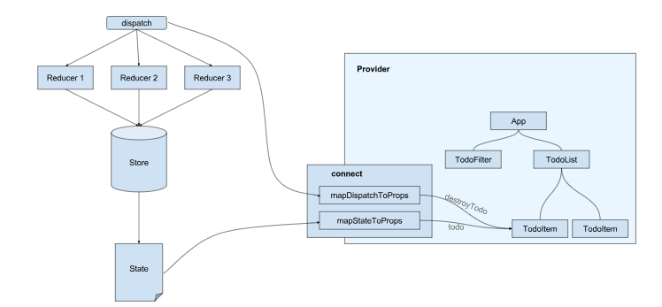
connect is established through the Provider

Slide 8
Procedures react redux connection in brief..
There is no way to directly interact with the store.
We can either retrieve data by obtaining its current state,
or change its state by dispatching an action
we only have access to the top and bottom component of the redux flow diagram shown previously.
mapStateToProps and mapDispatchToProps are both pure functions
that are provided the stores “state” and “dispatch” respectively.
Furthermore, both functions have to return an object,
whose keys will then be passed on as the props of the component they are connected to.
In this case, mapStateToProps returns an object with only one key : “todo”, and
mapDispatchToProps returns an object with the destroyTodo key.
only components within the Provider can be connected

